Slide 1





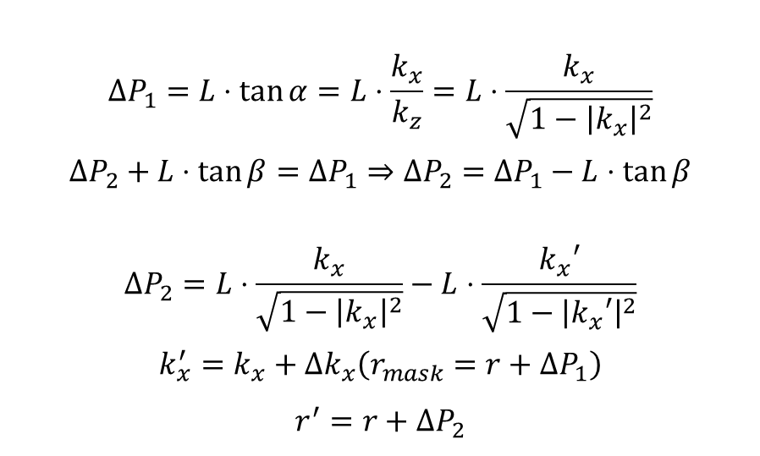






$$α$$
$$ΔP_{1}$$
$$β$$
Mask
Backward
$$α$$
$$β$$
L
$$β$$
$$α$$
Light Field
$$ΔP_{1}=L⋅\tan{α}=L⋅\frac{k_{x}}{k_{z}}=L⋅\frac{k_{x}}{\sqrt{1−{\left|k_{x}\right|}^{2}}}$$
$$ΔP_{2}+L⋅\tan{β}=ΔP_{1}⇒ΔP_{2}=ΔP_{1}−L⋅\tan{β}$$
$$ΔP_{2}=L⋅\frac{k_{x}}{\sqrt{1−{\left|k_{x}\right|}^{2}}}−L⋅\frac{k_{x}′}{\sqrt{1−{\left|k_{x}′\right|}^{2}}}$$
$$k_{x}^{′}=k_{x}+Δk_{x}\left(r_{mask}=r+ΔP_{1}\right)$$
$$r^{′}=r+ΔP_{2}$$
$$ΔP_{2}$$
$$ΔP_{1}$$
$$r$$
$$r′$$

Slide 2

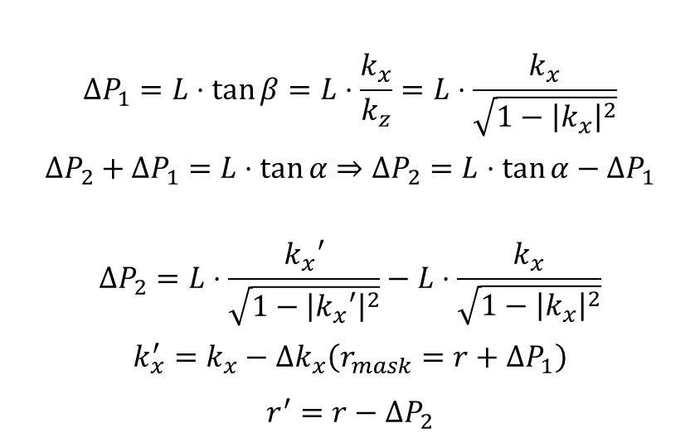


$$α$$
$$ΔP_{1}$$
$$β$$
Mask
Forward
$$α$$
$$β$$
L
$$β$$
$$α$$
Light Field
$$ΔP_{1}=L⋅\tan{β}=L⋅\frac{k_{x}}{k_{z}}=L⋅\frac{k_{x}}{\sqrt{1−{\left|k_{x}\right|}^{2}}}$$
$$ΔP_{2}+ΔP_{1}=L⋅\tan{α}⇒ΔP_{2}=L⋅\tan{α}−ΔP_{1}$$
$$ΔP_{2}=L⋅\frac{k_{x}′}{\sqrt{1−{\left|k_{x}′\right|}^{2}}}−L⋅\frac{k_{x}}{\sqrt{1−{\left|k_{x}\right|}^{2}}}$$
$$k_{x}^{′}=k_{x}−Δk_{x}\left(r_{mask}=r+ΔP_{1}\right)$$
$$r^{′}=r−ΔP_{2}$$
$$ΔP_{2}$$
$$ΔP_{1}$$
$$r′$$
$$r$$

Slide 3
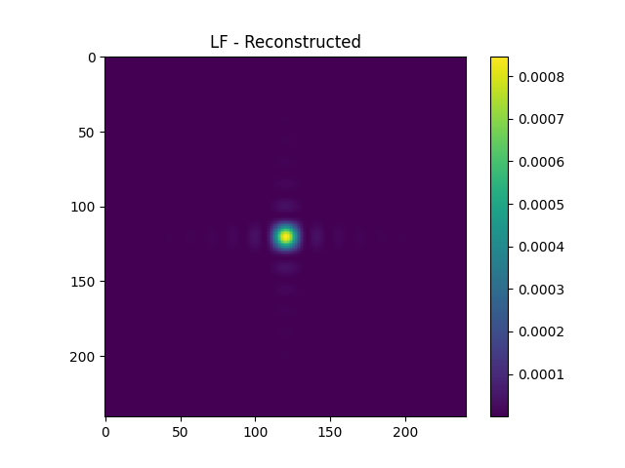
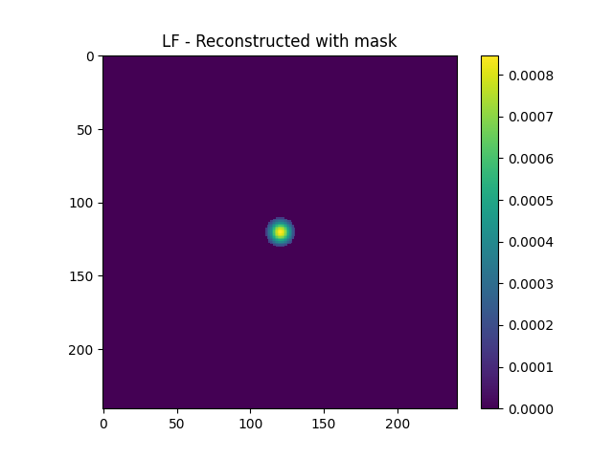

Baseline
$Energy Ratio(ER)=\frac{sum\left(LF_{reconstructed with mask}\right)}{sum(LF_{original with mask})}$

Slide 4

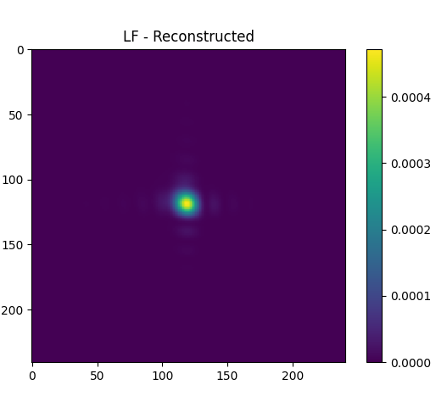
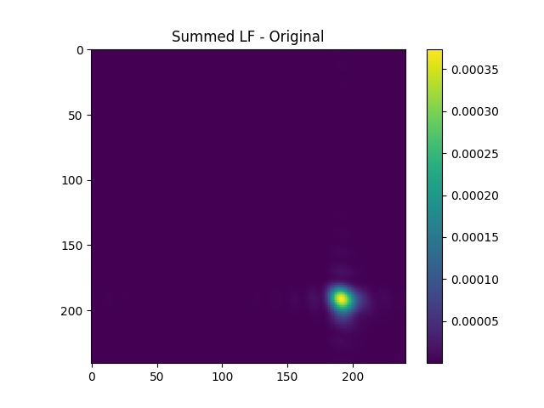
Pure Frequency
Backward
Forward

Slide 5
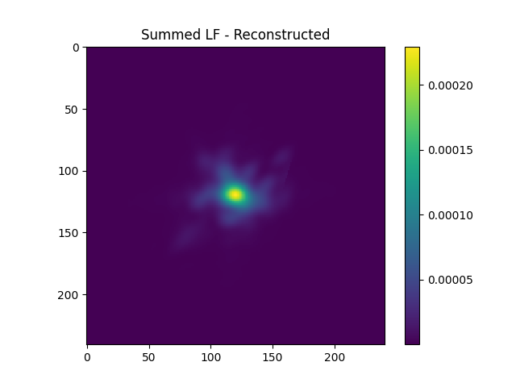
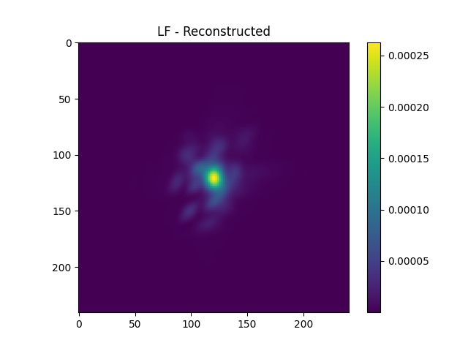
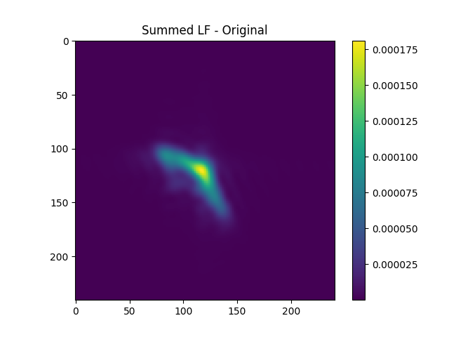
Random Mask
Backward
Forward

Slide 6
Energy Ratio
 | None | Pure Freq | Random
Forward | 0.72 | 0.527 | 0.267
Backward | 0.72 | 0.383 | 0.246
Total Energy | 0.179 | 0.129 | 0.191

Slide 7

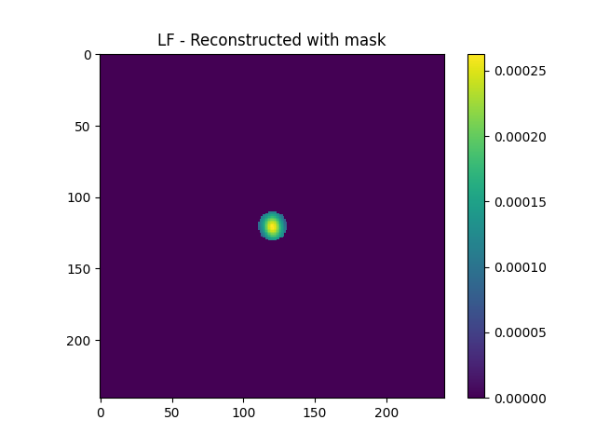
Locations

Slide 8

~Gradient Algorithm – Utility Function
$$F=\sum_{r}{I\left\{r^{′}\left(r,θ\right)∈A\right\}⋅LF\left(r,θ\right)}$$
$$φ=argmaxF$$

Slide 9

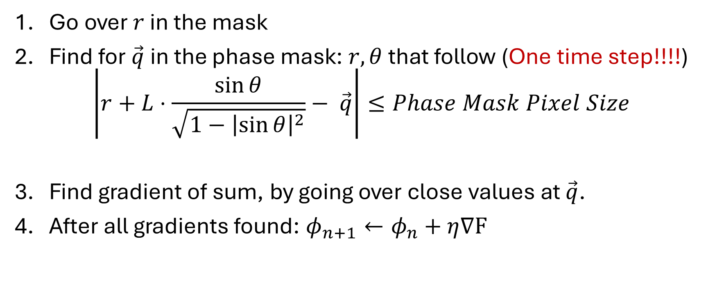
~Gradient Algorithm - Backward
$$\vec{q}$$
Go over $r$ in the mask
Find for $\vec{q}$in the phase mask: $r,θ$ that follow (One time step!!!!)
$$\left|r+L⋅\frac{\sin{θ}}{\sqrt{1−{\left|\sin{θ}\right|}^{2}}}− \vec{q}\right|≤Phase Mask Pixel Size$$
Find gradient of sum, by going over close values at $\vec{q}$.
After all gradients found: $φ_{n+1}←φ_{n}+η∇F$

Slide 10

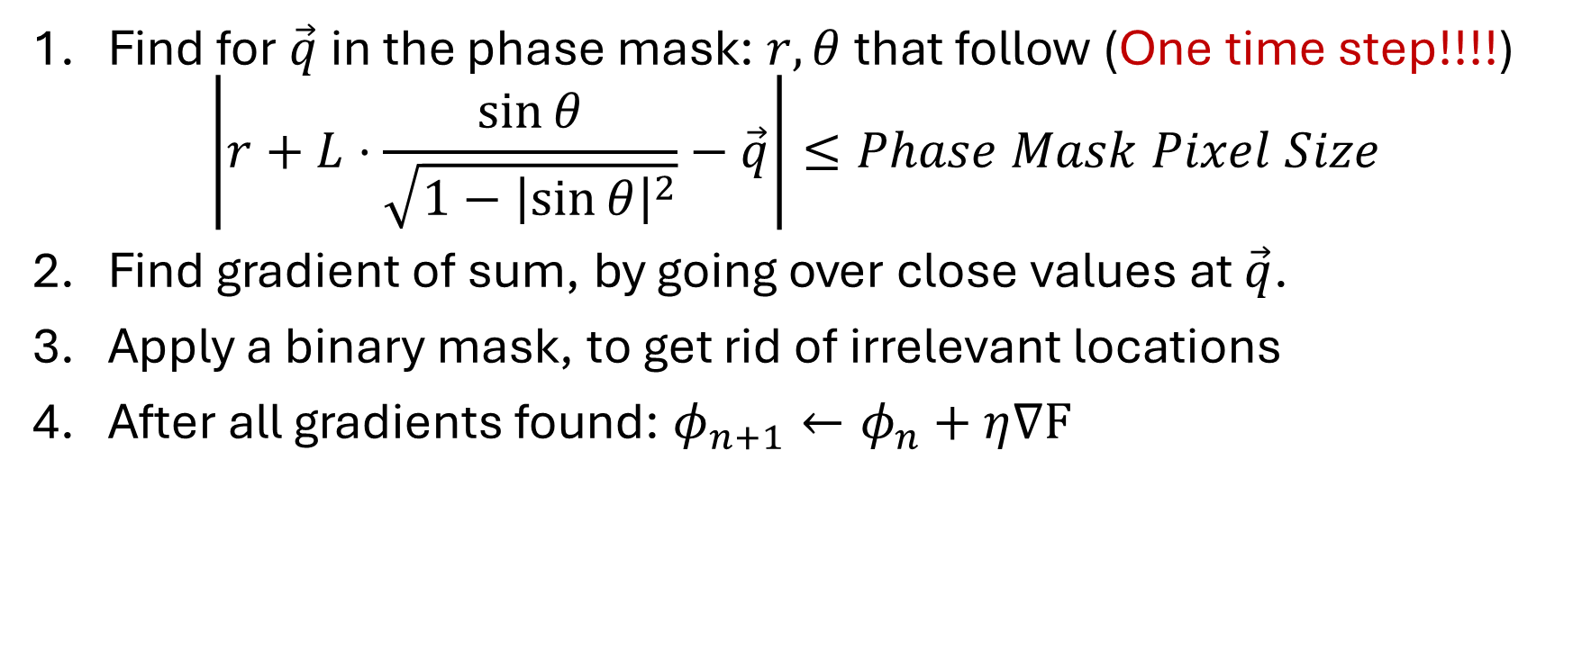
~Gradient Algorithm - Forward
$$\vec{q}$$
Find for $\vec{q}$in the phase mask: $r,θ$ that follow (One time step!!!!)
$$\left|r+L⋅\frac{\sin{θ}}{\sqrt{1−{\left|\sin{θ}\right|}^{2}}}−\vec{q}\right|≤Phase Mask Pixel Size$$
Find gradient of sum, by going over close values at $\vec{q}$.
Apply a binary mask, to get rid of irrelevant locations
After all gradients found: $φ_{n+1}←φ_{n}+η∇F$

